Slide 1

(Automated) Text Analysis of German Online Participation Projects with an Interdisciplinary Approach from Computer Science and Communication and Media Studies
Matthias Liebeck
Computer Science
Heinrich Heine University Düsseldorf
Katharina Esau
Communication and Media Studies
Heinrich Heine University Düsseldorf
@matthiasliebeck
@kathaesa
Special Session on Computational Social Science @ ECDA 2018
Paderborn, 05.07.2018
Slides: https://www.liebeck.io/talks

Slide 2

Introduction Online Participation
Online participation platforms:
  online platforms that include people into (political) decision-making processes
  usually forum-like
  revolve around a predefined topic, for instance about a park renovation
  typical ways of participating:
    propose ideas
    write comments
    upvote and downvote texts of other users
Depending on the topic of discussion, such a platform might have several thousand text contributions
their analysis is required by law
Politicians are interested in the discussion results. Possible research questions include:
  Which suggestions and ideas are contributed by the citizens? What do people want to be built or decided upon?
  Which reasons do the citizens provide for the realization of their suggestions? How do they argue for and against these ideas?
  How is the discussion style? Is it factual or emotional?
  How does a response of a user influence future responses?

Slide 3
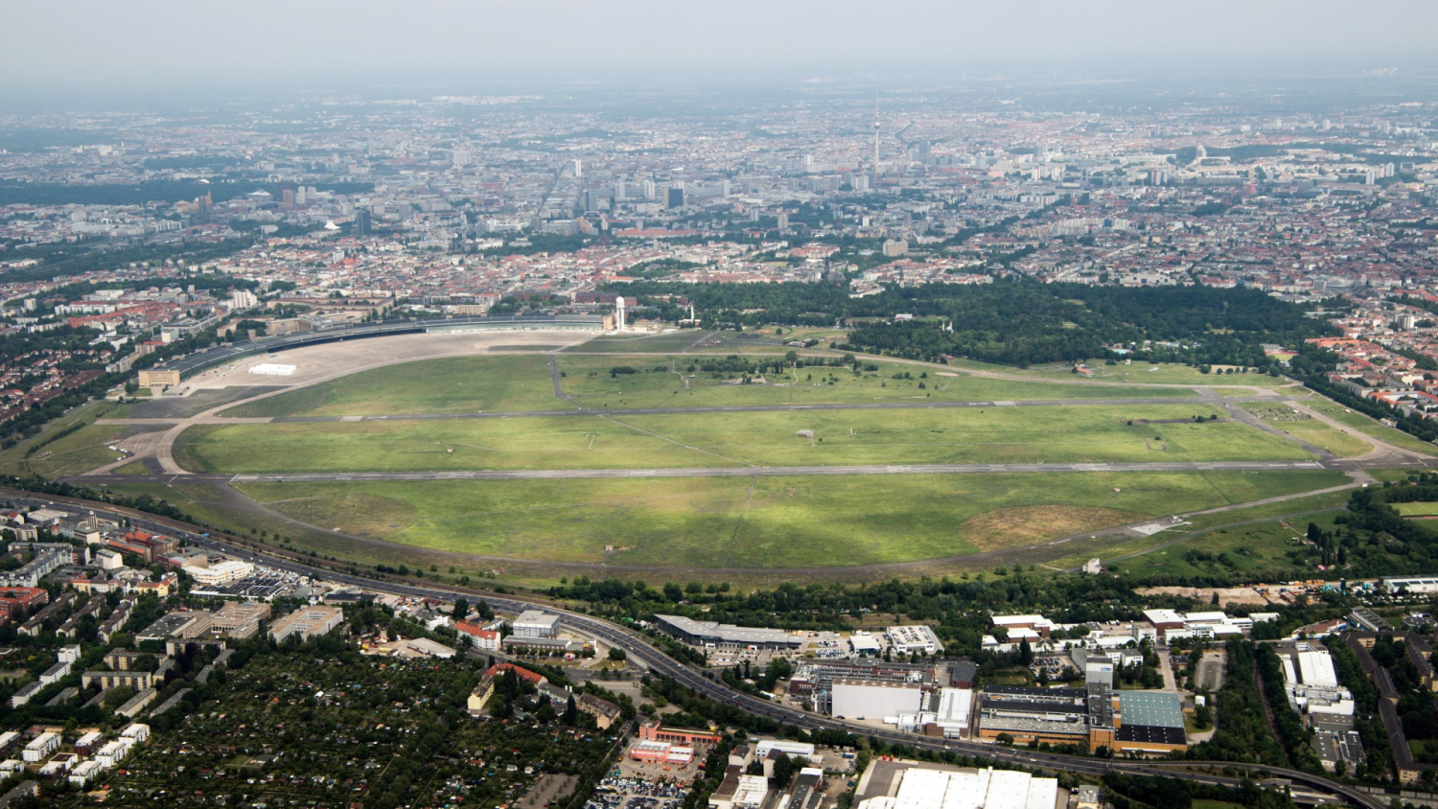
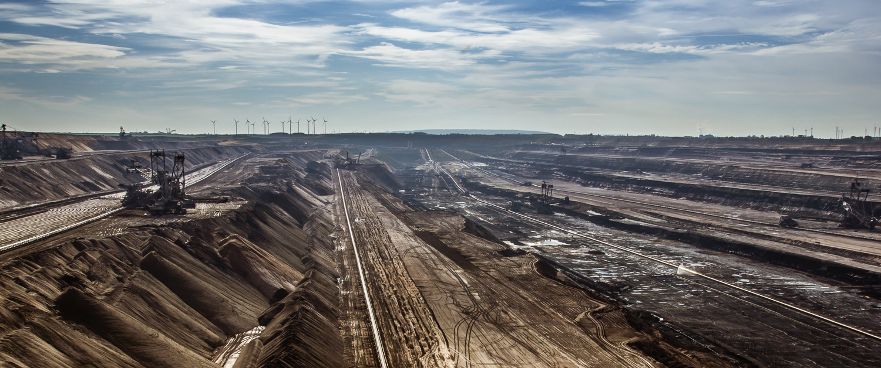
Online Participation Corpora
Tempelhofer Feld
Leitentscheidung Braunkohle
Topic: Future use of the former airport Berlin-Tempelhof (THF)
Topic: Future of lignite mining in North Rhine-Westphalia

Slide 4
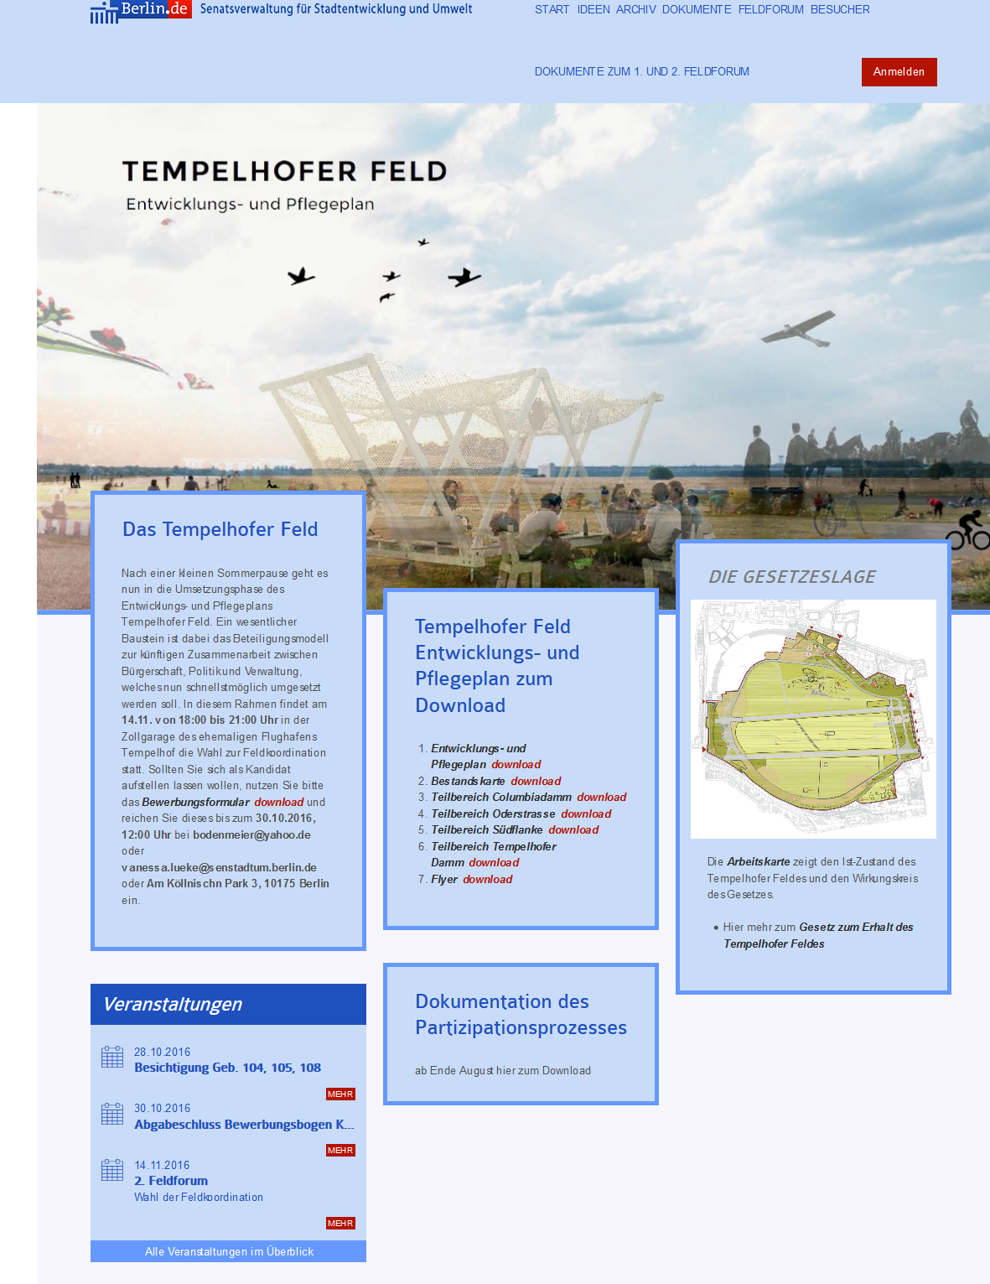
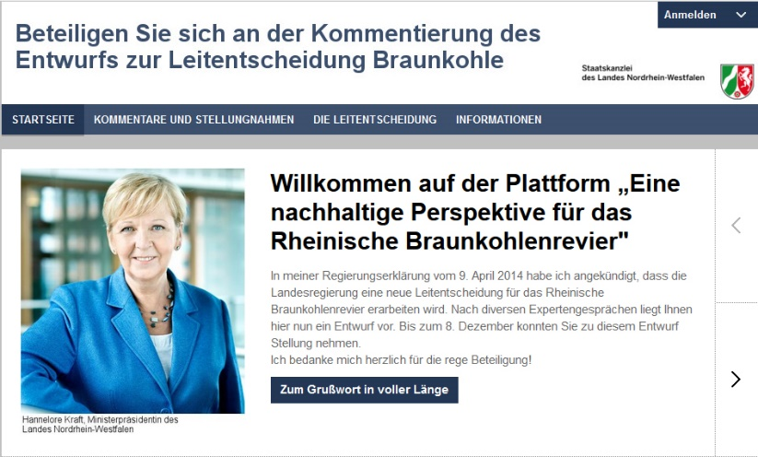
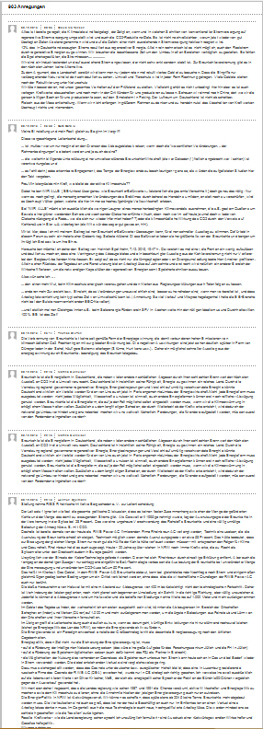
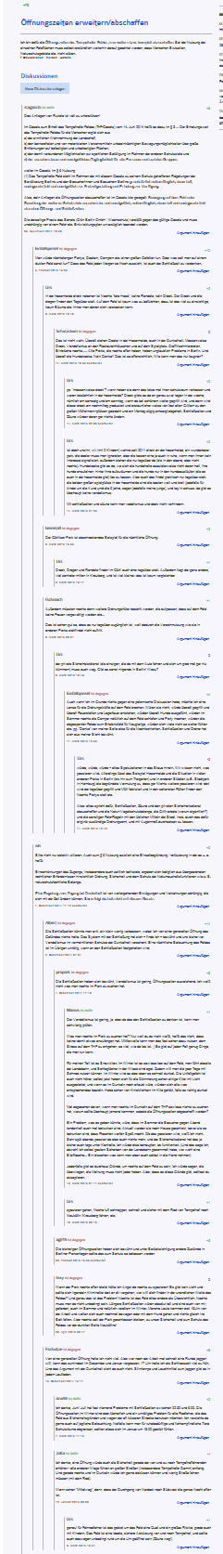
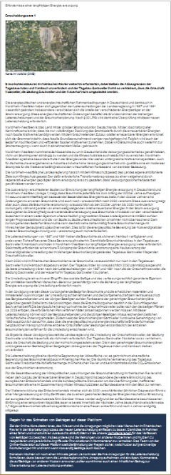
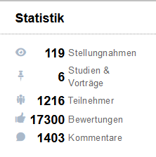
Online Participation Corpora
Tempelhofer Feld
Leitentscheidung Braunkohle
Topic: Future use of the former airport Berlin-Tempelhof (THF)
Topic: Future of lignite mining in North Rhine-Westphalia

Slide 5

Our Interdisciplinary Team
Which conditions were given for our joint research?
  Same graduate school on online participation but from different disciplines
    Katharina: commucation and media studies
    Matthias: computer science
  Both of us PhD students were using text contributions as the basis for our research
How did we start working together?
  Search for common research goals, automated text analysis
  We explained each other how research in our respective discipline works:
    Communication and media studies: Definitions/terms, theory-based research
    Computer science: Basics of machine learning
    Publication forms (e.g., conference articles vs. journals) and rankings of publication venues

Slide 6
Annotated variables
In the last three years, we annotated two corpora:
  Tempelhofer Feld: 340 threads + 1389 comments
  Leitentscheidung Braunkohle: 7 threads + 1296 comments
In our latest annotation, we annotated the following variables:
In this talk, we will focus on argument components.
topic relevance
real name vs. pseudonym
gender
major positions
pro stance
contra stance
a post‘s overall stance towards a major position
premises
narrations
positive emotions
negative emotions
humor
greetings
disrespect
questions
reflexivity
empathy
references to other posts

Slide 7
Argument Mining
Argument mining: extraction of arguments from text
Argument model: different components of argumentation and how they fit together
It was necessary to find an argument model that fits best for our application domain.
Habernal et al., (2014): “There is no one-size-fits-all argumentation theory to be applied to realistic data on the Web.“
Over the course of three months, we tested multiple existing argument models, e.g., Toulmin (1958) and the claim-premise family.
Toulmin‘s argumentation model:
data
qualifier
claim
warrant
rebuttal
backing

Slide 8
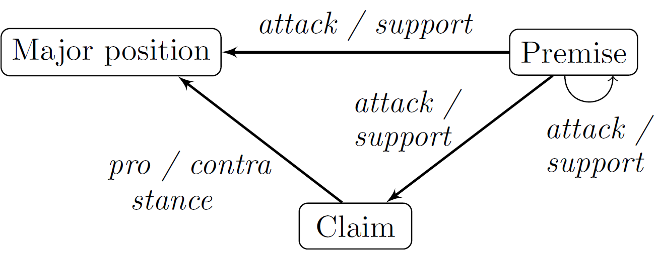
Argument Mining
Ultimately, we modified an existing model to fit our application domain online participation (Liebeck et al., 2016):
  major positions: Options for actions and decisions that occur in the discussion. They are most often someone‘s vision or something new or of a policy change.
  claims (pro claims / contra claims): Pro or contra stance toward a major position.
  premises: Reasons that attack or support a major position, a claim or another premise.
Examples from the corpus:
  major position: “We hope that children’s playgrounds in the open-air space will be compatible with the ThF law in the future.“
  claim: “I am rather critical of the creation of simple playgrounds even though I have children myself.“
  premise: “As a father of two children I am missing one or two children’s playgrounds on the field.“

Slide 9
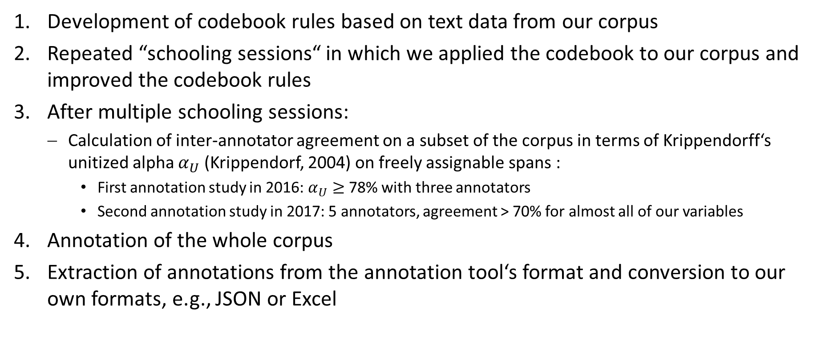
Annotation Process
Development of codebook rules based on text data from our corpus
Repeated “schooling sessions“ in which we applied the codebook to our corpus and improved the codebook rules
After multiple schooling sessions:
  Calculation of inter-annotator agreement on a subset of the corpus in terms of Krippendorff‘s unitized alpha $α_{U}$ (Krippendorf, 2004) on freely assignable spans :
    First annotation study in 2016: $α_{U}≥$ 78% with three annotators
    Second annotation study in 2017: 5 annotators, agreement > 70% for almost all of our variables
Annotation of the whole corpus
Extraction of annotations from the annotation tool‘s format and conversion to our own formats, e.g., JSON or Excel

Slide 10
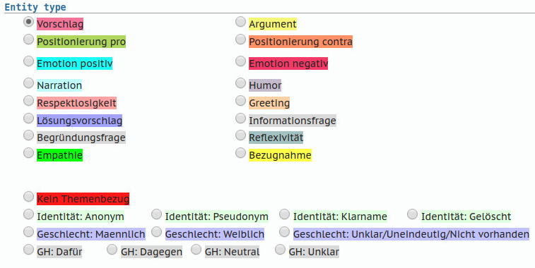
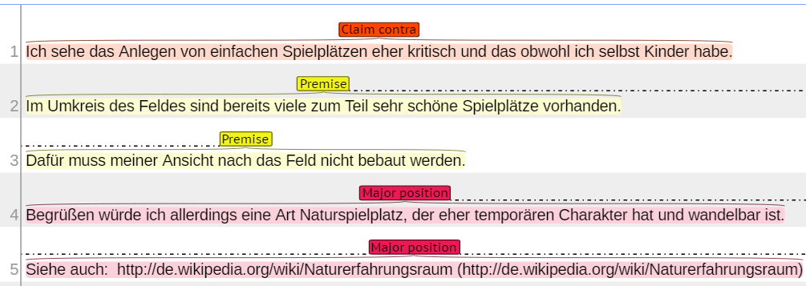
Technology
Annotation tool: brat rapid annotation tool
Example of annotated text content
Variable selection dialog

Slide 11
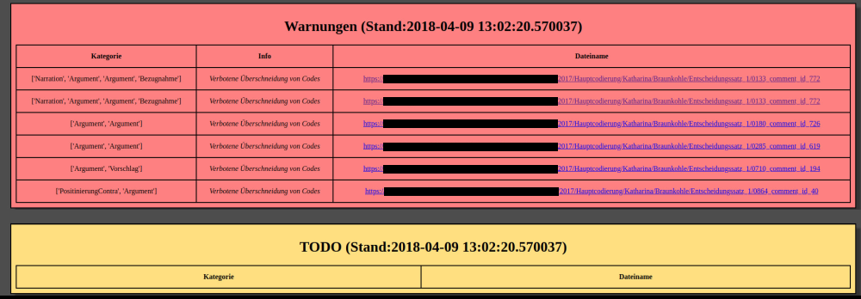
Technology
Warning tool:
  We used freely assignable spans in our annotation and also annotated metadata, e.g., the author‘s gender.
  We wrote a warning tool that parses annotations and points out errors, e.g., missing or overlapping annotations.

Slide 12
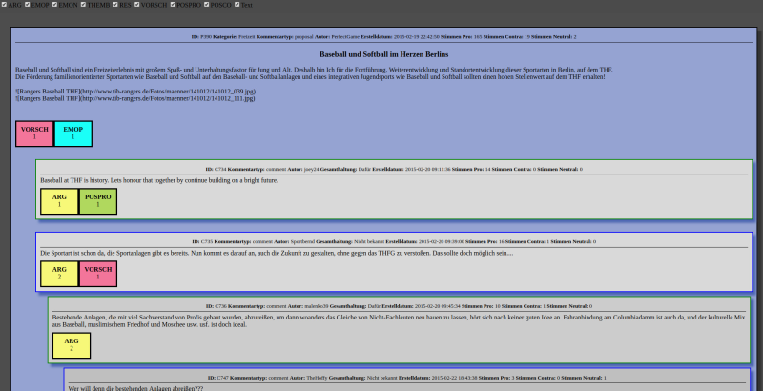
Technology
HTML visualization of annotions, used during the annotation and afterwards

Slide 13
Machine Learning
Previous machine learning results one third of the THF corpus in terms of macro-averaged F1:
Our experiments on both corpora (inluding cross-dataset experiments) are currently being repeated in a student‘s master thesis.
Method | Identify argumentative sentences | Classify argumentative sentences
Classical machine learning | 69.71% | 67.26%
Deep Learning | 68.51% | 68.59%

Slide 14
Advantages and Problems of Interdisciplinary Teams
Advantages:
ability to learn research approaches from other fields
strengthens the understanding of one‘s own discipline
fun ;-)
Problems:
“warm-up time“ necessary
difficult to find team members with the same research goal
depending on the discipline, it may be difficult to be accepted in the community

Slide 15
Questions?
Slides: https://www.liebeck.io/talks

Slide 16
Images Sources
Image sources:
Twitter Logos: Official Twitter Media Presskit (https://about.twitter.com/de/company/brand-resources.html)
Gemeinderat: https://www.meinbezirk.at/eisenstadt/politik/grosshoeflein-spvp-als-koalition-stimmt-im-gemeinderat-gegen-das-eigene-projekt-m12979048,2190334.html
THF: https://www.bz-berlin.de/data/uploads/2017/09/e00f086045f_1504769900-1920x1080.jpg
Garzweiler: http://www.picstah.de/wp-content/uploads/2013/10/garzweiler-pano.jpg
Screenshot von https://tempelhofer-feld.berlin.de
Screenshot von leitentscheidung-braunkohle.nrw
Argument model: Liebeck et. al, 2016
References:
Ivan Habernal, Judith Eckle-Kohler, and Iryna Gurevych (2014). “Argumentation Mining on the Web from Information Seeking Perspective”. In: Proceedings of the Workshop on Frontiers and Connections between Argumentation Theory and Natural Language Processing, pp. 26–39
Stephen Toulmin (1958). The Uses of Argument. Cambridge University Press.
Matthias Liebeck, Katharina Esau, and Stefan Conrad (2016). “What to Do with an Airport? Mining Arguments in the German Online Participation Project Tempelhofer Feld”. In: Proceedings of the Third Workshop on Argument Mining (ArgMining2016), pp. 144–153

